Slide 1
Software Carpentry Final Project – Push_Box/Sokoban
by Yinong Zhao

Slide 2
Project Idea
Sokoban is a type of transport puzzle, in which the player pushes boxes or creates around in a warehouse, trying to get them to storage locations. The puzzle is usually implemented as a video game.
creator:
Hiroyuki Imabayashi
published in 1982 by Thinking Rabbit

Slide 3
Project idea
Why I choose this project?
played too many video games in lifetime, big games like Starcrafts, etc.
designed by others
but never designed a game by my own, except for maze/lazor
in fact, not designing a game, merely find the solution
Why?
cause if only by hand, it’s too hard for a certain level when there are too many boxes and slots!

Slide 4
Project Challenges
hard for humans. when number of boxes increase, it’s just hard to pick the exact one to start.
easy for computers? I thought so, but I was wrong!!
Why not try out every possibilities?

Slide 5
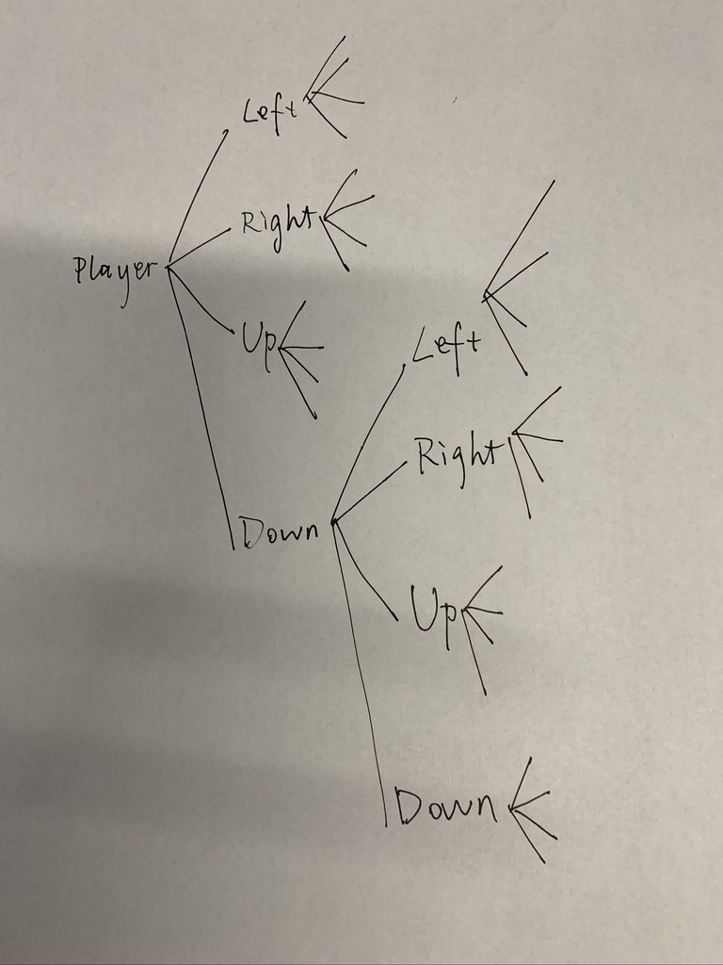
Project Challenge
Naïve!!
right thing to do:
keep a stack/maintain a board_status
what stack?
a little bit like the [maze]

